Slide 1
Exploiting Autonomy for Enhancing Remotely Guided Operation of Ground Vehicles
Presented by:
AKASHLEENA SARKAR
GTID: 903549225
SUMMER INTERN, GEORGIA TECH

Slide 2
Objective:
The objective is to find how autonomy would enhance remote teleguidance and improve the situational awareness and task performance.

Slide 3
INTRODUCTION

Slide 4
Teleguidance- A Human Robot Interaction framework
An important question is not-
“What can a robot do ?,”
but rather
“What should a robot do, and to what extent?”

Slide 5
MOTIVATION AND CHALLENGES
Motivation- “Service Robots”, Rescue operation.
Challenges-
HRI is application specific.
Difficult to define common metrics to define, measure and evaluate task performance that can be used in wide range of HRI systems.

Slide 6
TASK MISSION
Three test cases:
1. Teleoperate the turtlebot manually in the fourth floor corridoor and measure task performance metrics.
2. Run PIPS code on turtlebot ,navigate turtlebot on fourth floor autonomouslyand analyze performance metrics.
3. Remote teleguidance : Run turtlebot on fourth floor world autonomously , the goal being decided by the user.(HRI)

Slide 7
Quantitative Performance Metrics
Metrics that consider the security in the trajectory or proximity to obstacles (Safety Metrics SM)
Metrics that consider dimension of trajectory towards goal
Metrics that evaluate smoothness of trajectory
Metrics that consider the complexity of the environment and determine the sensitivity and robustness of the robot.
Time Metrics

Slide 8
Description of Objective Parameters

Slide 9
Safety Metrics (SM)
Metrics that consider the security in the trajectory or proximity to obstacles
SM1= Mean distance between vehicle and the obstacles through the entire mission measured by the sensor.
SM2= Minimum distance between any sensor and any obstacle through the entire trajectory. This index measures the maximum risk taken throughout the entire mission.
Relevance:SM1 gives an overall perspective of the proximity between the obstacle and the robot throughout the task whereas SM2 measures the maximum closeness or the maximum risk factor of the robot.

Slide 10
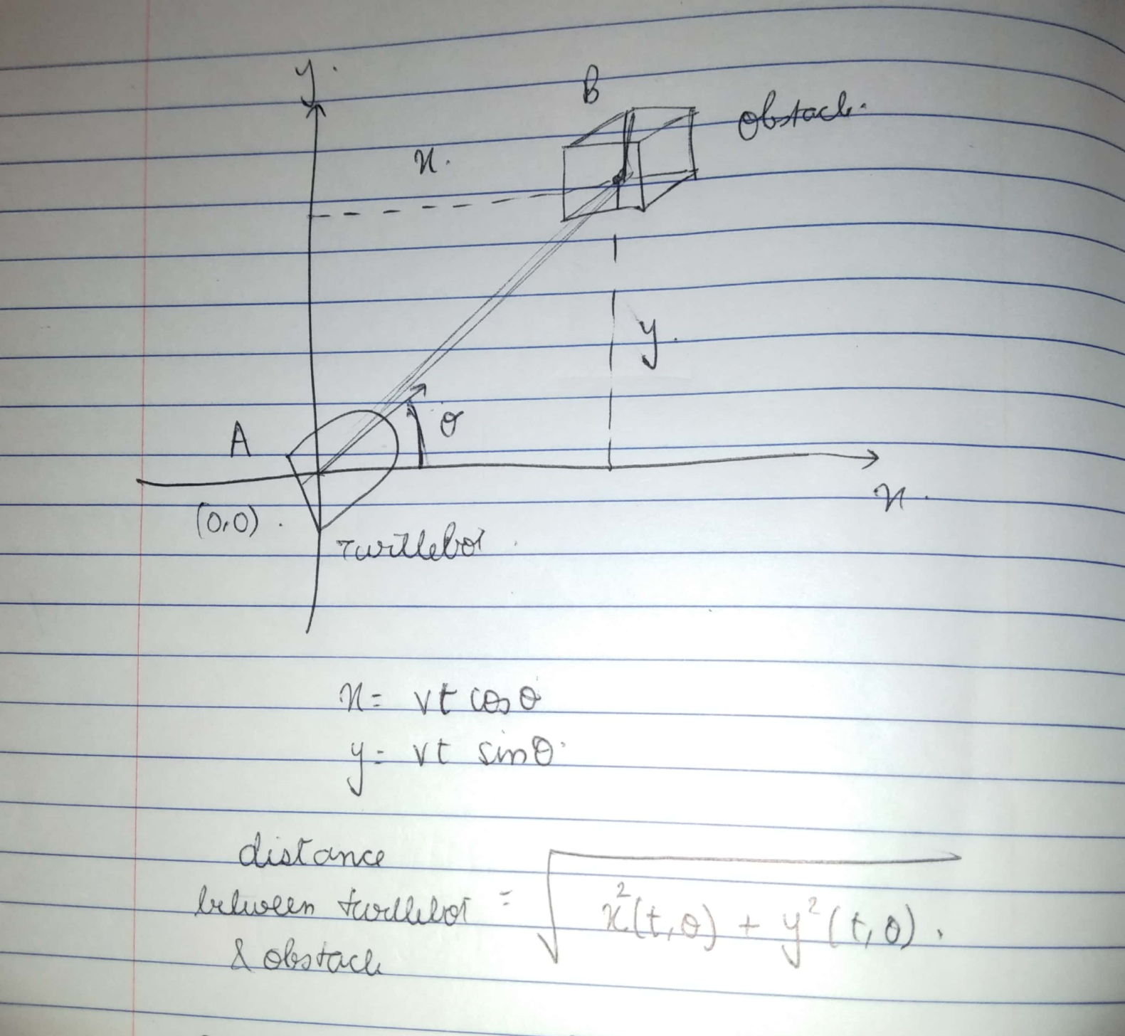
EQUATIONS

Slide 11
How do we measure it/ Survey instrument to be used?
= KINECT mounted on turtlebot
di= ith depth value as received from sensor.

Slide 12
Method of evaluation
The depth values of the Kinect sensors will be stored in ROS Bags and later retrieved and tabulated in our observation table. For all the 3 task mission we will compare the values of SM1 and SM2 from the observation table.
Lower the SM1 and SM2 values: lesser the security distance of robot = better performance

Slide 13
Dimension Metrics (DM)
Relevance to my project:
An important aspect when determining the quality of the robot navigation system is the ability to follow a trajectory that aims to reach a goal
Benchmark - Optimal Trajectory???
An optimal trajectory is defined as the line with minimum length and zero curvature between the initial point (xi,yi) and (xn,yn) covered in the minimum time.
Comparison between:
Length of optimal trajectory &
Length of the Covered Trajectory (PL):

Slide 14
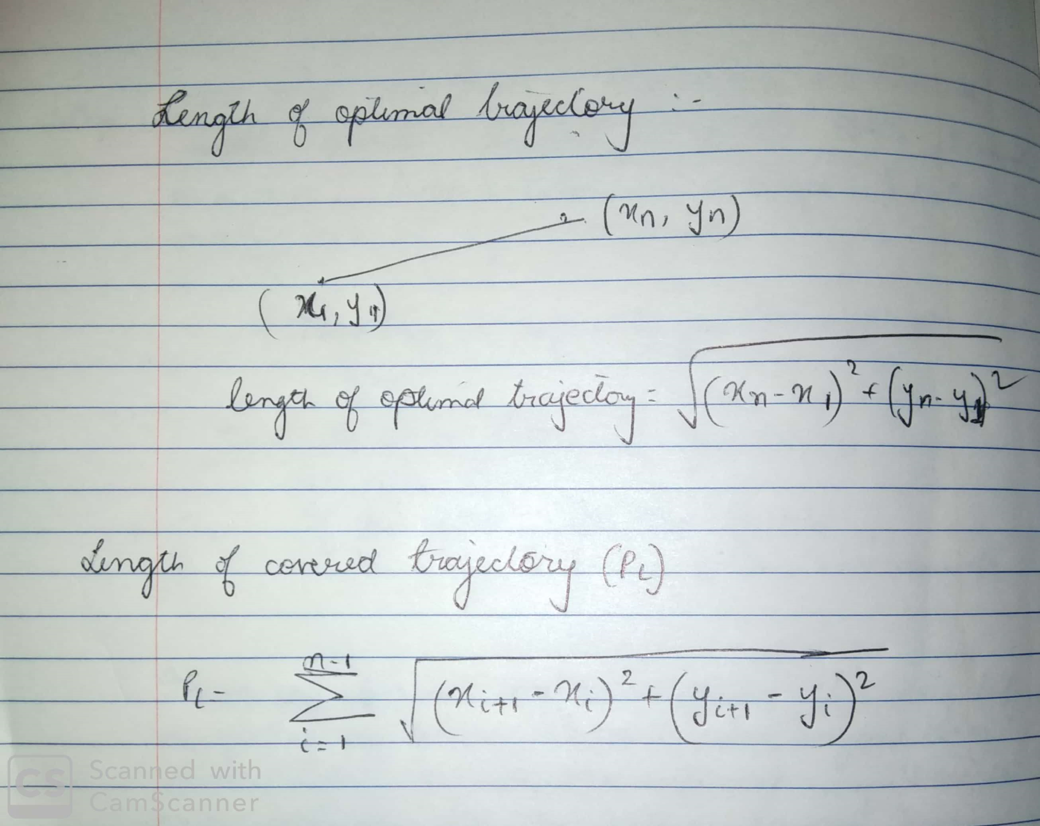

Slide 15
Method of Evaluation
The co-ordinates at every instance t (xi,yi) can be retrieved from the ROSBAG
Hypothesis: We expect this difference to be minimum in case of task 2 and task 3 than in Task 1 since in autonomous algorithm the shortest distance and trajectory optimization concept is taken into consideration which is not considered in manual teleoperation.

Slide 16
Smoothness Metrics
Smooth trajectory enables energy and time saving because it is easily and readily negotiable.
The bending energy BE, a function of curvature k is used to evaluate the smoothness of the robot motion.

Slide 17
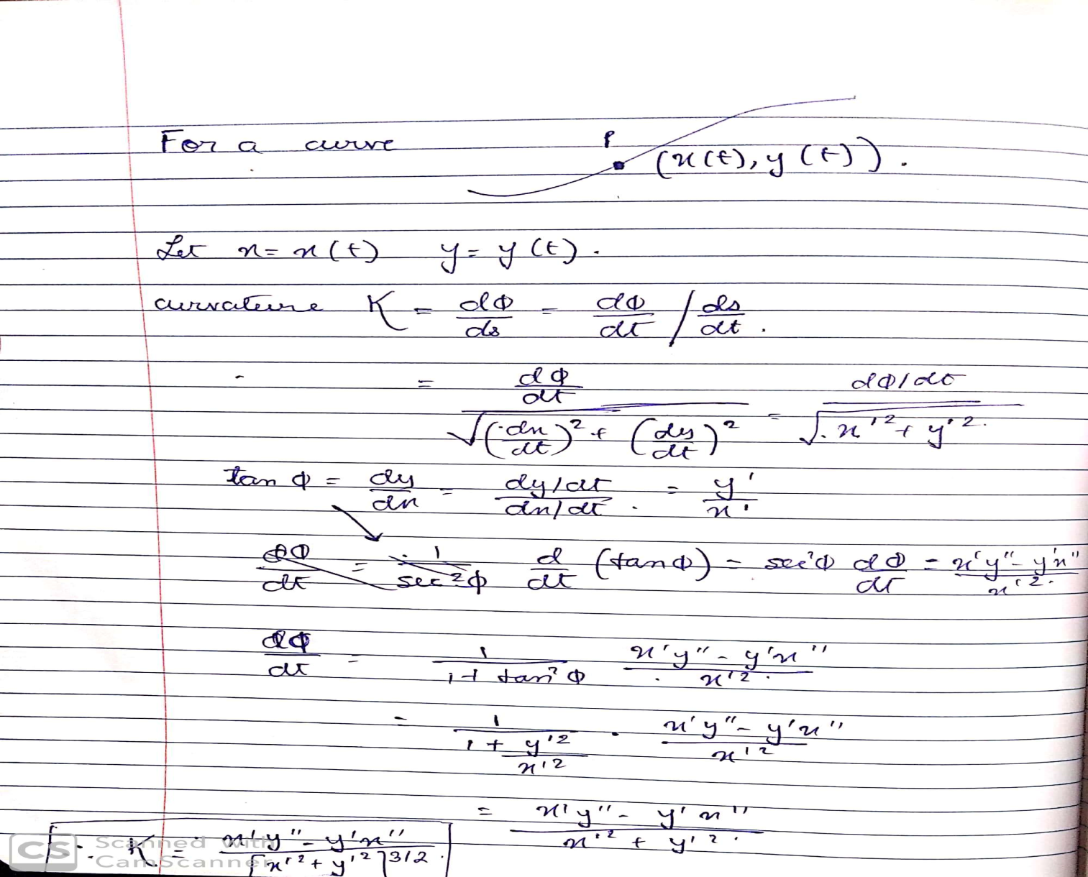
Smoothness Metrics
https://ri.cmu.edu/pub_files/pub2/rosenblatt_julio_1997_1/rosenblatt_julio_1997_1.pdf

Slide 18
Smoothness Metrics
Not adding this metrics to our project rather it goes in literature review “ How autonomy improves teleoperation”?
Relevant Recent Research by MIT in May 2019: [Link] Research Article
Development of an Autonomous control system that "learns“(Convolutional Neural Network) the steering patterns of human drivers using only data from video camera feeds and a simple GPS-like map.
The trained system can control a driverless car along a planned route in a brand-new area, by imitating the human driver.
"For example, if we train an autonomous vehicle to drive in an urban setting such as the streets of Cambridge, the system should also be able to drive smoothly in the woods, even if that is an environment it has never seen before."

Slide 19
Metrics that consider the complexity of the environment
Hypothesis: With the increase in complexity of the environment, there is an anticipated increase in navigation time and difficulty in manuevring the environment.

Slide 20
Metrics considering Number of collisions:
Number of collisions per distance per time:
Value added to my project:
A 100 percent successful mission =robot navigates and reaches the goal point with zero collisions with obstacles.
number of collisions per distance per time is inversely proportional to task performance.

Slide 21
Experiment 1:
WORLD: 1. PERFORM IN GAZEBO FOURTH FLOOR WORLD FOR ALL 3 TASK METHODS
WORLD 2: PERFORM IN REAL WORLD FOR ALL 3 TASK METHODS
COMPARE THE GAP BETWEEN GAZEBO AND REAL WORLD

Slide 22
Procedure to be implemented in Gazebo World :
Task 1 :Manual Teleoperation
In gazebo fourth floor world, the user manually teleoperates the robot to reach a specific goal position .
Start a timer that would record the time taken to traverse the robot to reach a goal position .
Set a counter variable/ or count manually the number of obstacles in the path,
Store the data (number of obstacles in the path of the robot) and make a real time plot of the data . [MATPLOTLIB? ANY OTHER WAY TO DO THIS???]
Increase the number of obstacles in the path of the robot and repeat the above process for another 3 runs.

Slide 23
Task 2 : Fully autonomous PIPS Setup:
In gazebo fourth floor world , run pips controller and let robot navigate autonomously .
Note down
1. the time taken to traverse the trajectory and
2. the number of obstacles in the path of the robot
3. Length of trajectory
4. Least distance between robot and obstacle throughout the journey ( SM1 and SM2)
5. Number of collisions
and construct a real time plot for the same.[MATPLOTLIB]
Increase the number of obstacles in the path of the robot and repeat the above process for another 3 runs.

Slide 24
3. Task 3: Semi Autonomous System
In gazebo fourth floor world with the same fixed goal position run pips code but now the robot autonously navigates to the mouse click point. The user keeps on deciding the intermediate steps to reach the goal via mouse clicks.
Start a timer that would record the time taken to traverse the robot to reach a goal position .
Set a counter variable/ or count manually the number of obstacles in the path,
Store the data and make a real time plot of the data . [MATPLOTLIB? ANY OTHER WAY TO DO THIS???]
Increase the number of obstacles in the path of the robot and repeat the above process for another 3 runs.

Slide 25
Methods of Evaluation: ( only for gazebo world)
Quantitative Parameters to be measured | Instrument used for measuring | Method Used for comparison between 3 tasks
The time taken to traverse the trajectory | Already available in ROS PIPS code . For manual teleoperation use ROS Clock | Readings of observation table . Plot between time of traversal and no of obstacles
The number of obstacles in the path of the robot | Already available in ROS PIPS code . For manual teleoperation use a counter variable. | Comparing results from observation table
Length of trajectory | Already available ROS PIPS python script file. For manual teleoperation calculate length of trajectory using discrete co-ordinates stored in ROSBAGS | Comparison between length of optimal trajectory length and length of covered trajectory
Least distance between robot and obstacle throughout the journey ( SM1 and SM2) | Sensor depth values stored in ROS BAGS | Comparing results from observation table
Number of collisions in the path of the robot | Publish as ROS message | Comparing results from observation table

Slide 26
Method of evaluation of the above metrics:
Compare the Plot of time taken for traversal vs number of obstacles in path of robot for all 3 cases and analyze task performance.

Slide 27
Experiment 2: On field experiment to measure Situational Awareness

Slide 28
Situational Awareness Methodology
HCI based Usability test – “voicing your thoughts”
Redesign interface elements where faced difficulty.
SETUP:-
Robots remotely controlled by humans were asked to search for tagged victims in an arena consisting of partially destroyed buildings.
Humans had never seen the arena before the run.
Humans could not see the robot in operation.

Slide 29
Data collection
Videotaped the robot's progress in the arena and recorded which parts of the arena it covered,
Captured the operator's manipulation of the interface
Captured the operator's voice
Conducted post-run interviews with the operator

Slide 30
Situational Awareness Parameters tested
Implicit parameter:
Amount of time spend panning the camera
Number of times the robot bumped elements in the environment
Explicit parameters
Testing method: Video tape analysis
operator's SA acquisition strategies
explicit self-assessment of SA

Slide 31
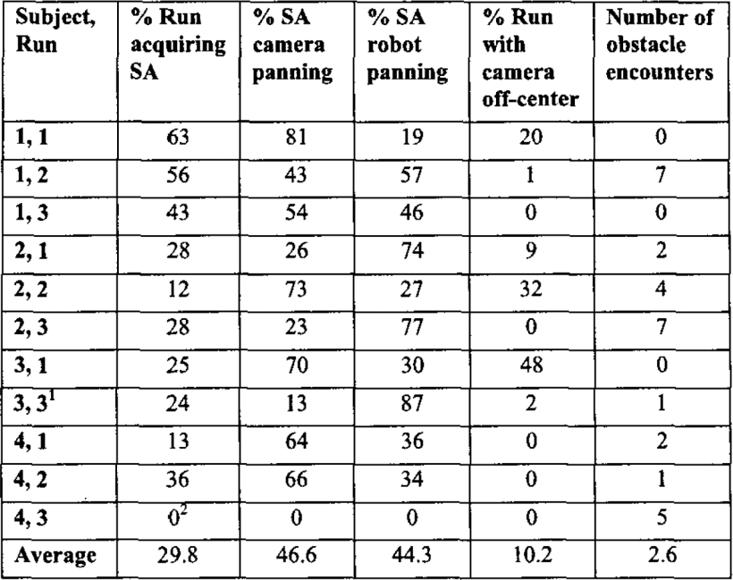
Expected Results

Slide 32
How enhances situational Awareness?
Real time in-situ app enhancing situational awareness: https://youtu.be/82ArilqsHOM

Slide 33
REFERENCES
Yanco, H. A., & Drury, J. (n.d.). “Where am i?” acquiring situation awareness using a remote robot platform. 2004 IEEE International Conference on Systems, Man and Cybernetics (IEEE Cat. No.04CH37583). doi:10.1109/icsmc.2004.1400762
Lampe, A., & Shatila, R. (a.n.d.). Performance measure for the evaluation of mobile robot autonomy. Proceedings 2006 IEEE International Conference on Robotics and Automation, 2006. ICRA 2006. doi:10.1109/robot.2006.1642325
Liu, Y.-C., & Chopra, N. (2013). Control of semi-autonomous teleoperation system with time delays. Automatica, 49(6), 1553–1565.doi:10.1016/j.automatica.2013.02.009
M. R. Endsley, S. J. Selcon, T. D. Hardiman, D. G. Croft, "A comparative analysis of SAGAT and SART for evaluations of situation awareness", Proceedings of the 42nd annual meeting of the Human Factors and Ergonomics Society, 1998, October 1998.

Slide 34
Thank You!!

